Slide 1
Spring boot and rest webservices
Mostafa Rastgar
june 2019

Slide 2
Agenda
Spring Boot vs Spring MVC vs Spring
Spring Initializer
Spring Boot Auto Configuration
Spring Boot Starters - Web and JPA
Spring Boot Starter Parent
Spring Boot Developer Tools and Live Reload
Logging with Spring Boot - Logback, SLF4j and LOG4j2
Introduction to Spring Data

Slide 3
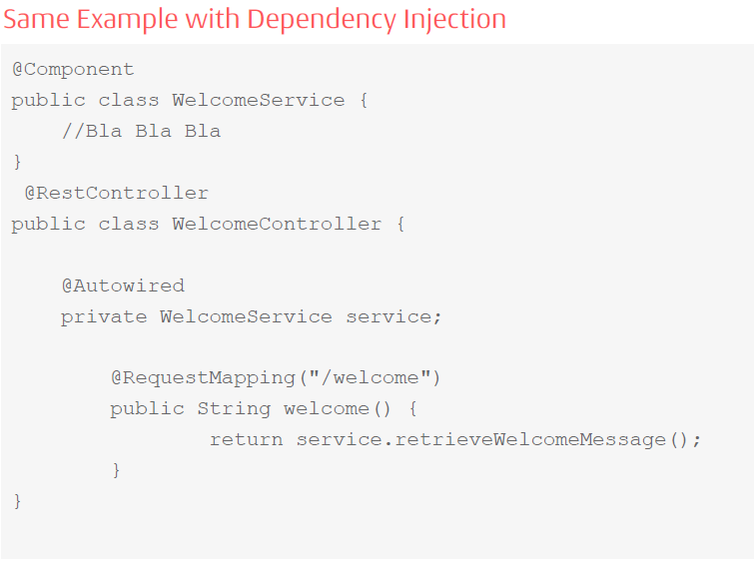
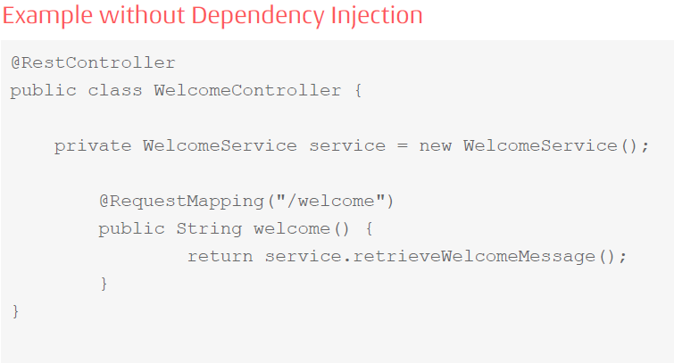
Spring Boot vs Spring MVC vs Spring
What is the core problem that Spring Framework solves?
Most important feature of Spring Framework is Dependency Injection. At the core of all Spring Modules is Dependency Injection or IOC Inversion of Control.

Slide 4
Spring Boot vs Spring MVC vs Spring
What else does Spring Framework solve?
Does Spring Framework stop with Dependency Injection? No. It builds on the core concept of Dependency Injection with a number of Spring Modules
Spring JDBC
Spring MVC
Spring AOP
Spring ORM
Spring JMS
Spring Test
Good Integration with Other Frameworks
Hibernate for ORM
iBatis for Object Mapping
JUnit & Mockito for Unit Testing

Slide 5
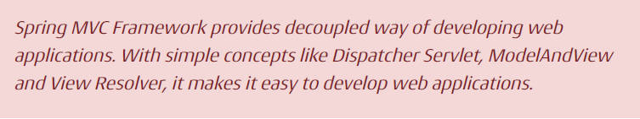
Spring Boot vs Spring MVC vs Spring
What is the core problem that Spring MVC Framework solves?
A conventional Spring MVC based project configuration:
component scan
dispatcher servlet
view resolver
web jars(for delivering static content) among other things
datasource, entity manager factory, transaction manager
…

Slide 6


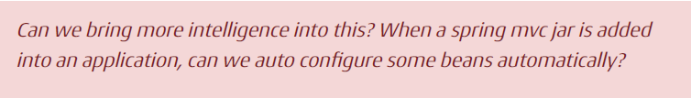
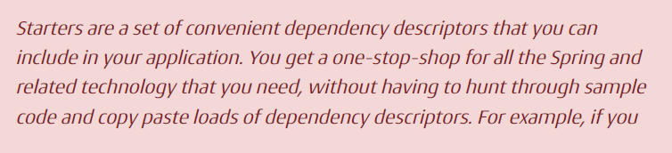
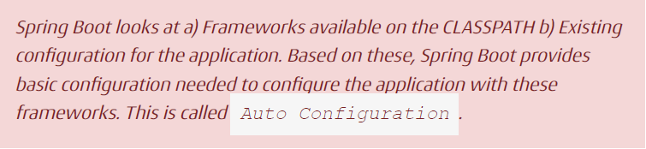

Spring Boot vs Spring MVC vs Spring
Why do we need Spring Boot?

Slide 7
Spring Boot vs Spring MVC vs Spring
Spring Boot Starter Project Options
spring-boot-starter-web-services - SOAP Web Services
spring-boot-starter-web - Web & RESTful applications
spring-boot-starter-test - Unit testing and Integration Testing
spring-boot-starter-jdbc - Traditional JDBC
spring-boot-starter-hateoas - Add HATEOAS features to your services
spring-boot-starter-security - Authentication and Authorization using Spring Security
spring-boot-starter-data-jpa - Spring Data JPA with Hibernate
spring-boot-starter-cache - Enabling Spring Framework’s caching support
spring-boot-starter-data-rest - Expose Simple REST Services using Spring Data REST
spring-boot-starter-actuator - To use advanced features like monitoring & tracing to your application out of the box
spring-boot-starter-undertow, spring-boot-starter-jetty, spring-boot-startertomcat - To pick your specific choice of Embedded Servlet Container
spring-boot-starter-logging - For Logging using logback
spring-boot-starter-log4j2 - Logging using Log4j2
Spring Boot aims to enable production ready applications in quick time
Actuator : Enables Advanced Monitoring and Tracing of applications.
Embedded Server Integrations - Since server is integrated into the application, I would NOT need to have a separate application server installed on the server.
Default Error Handling

Slide 8
Spring Initializer
Show Demo
Run with jetty
Run with undertow
<dependency>
<groupId>org.springframework.boot</groupId>
<artifactId>spring-boot-starter-web</artifactId>
<exclusions>
<!-- Exclude the Tomcat dependency -->
<exclusion>
<groupId>org.springframework.boot</groupId>
<artifactId>spring-boot-starter-tomcat</artifactId>
</exclusion>
</exclusions>
</dependency>
<dependency>
<groupId>org.springframework.boot</groupId>
<artifactId>spring-boot-starter-jetty</artifactId>
</dependency>
<dependency>
<groupId>org.springframework.boot</groupId>
<artifactId>spring-boot-starter-undertow</artifactId>
</dependency>

Slide 9
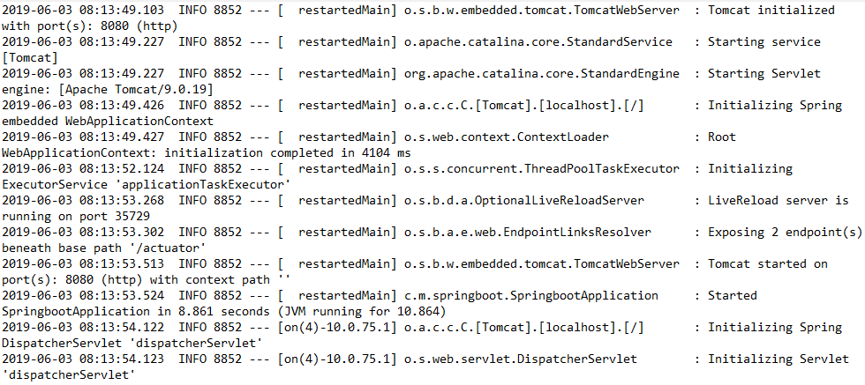
Spring Boot Auto Configuration
Launch Spring Initializer and choose the following dependencies
Web
Actuator
DevTools
Run the application and see the log

Slide 10
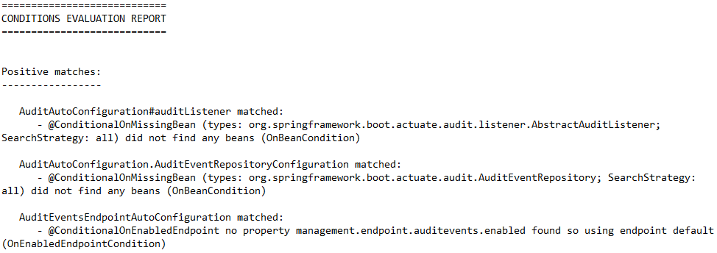
Spring Boot Auto Configuration
Where is Spring Boot Auto Configuration?
spring-bootautoconfigure.jar
/METAINF/spring.factories
Turn on debug logging to display auto-configured beans

Slide 11
Spring Boot Starters - Web and JPA
What if we do not have starter projects?
<dependency>
<groupId>org.springframework</groupId>
<artifactId>spring-webmvc</artifactId>
<version>4.2.2.RELEASE</version>
</dependency>
<dependency>
<groupId>com.fasterxml.jackson.core</groupId>
<artifactId>jackson-databind</artifactId>
<version>2.5.3</version>
</dependency>
<dependency>
<groupId>org.hibernate</groupId>
<artifactId>hibernate-validator</artifactId>
<version>5.0.2.Final</version>
</dependency>
<dependency>
<groupId>log4j</groupId>
<artifactId>log4j</artifactId>
<version>1.2.17</version>
</dependency>
<bean
class="org.springframework.web.servlet.view.InternalResourceViewResolver">
<property name="prefix">
<value>/WEB-INF/views/</value>
</property>
<property name="suffix">
<value>.jsp</value>
</property>
</bean>
<bean id="messageSource" class="org.springframework.context.support.ReloadableResourceBundleMessageSource">
<property name="basename" value="classpath:messages" />
<property name="defaultEncoding" value="UTF-8" />
</bean>
<mvc:resources mapping="/webjars/**" location="/webjars/"/>
<servlet>
<servlet-name>dispatcher</servlet-name>
<servlet-class>
org.springframework.web.servlet.DispatcherServlet
</servlet-class>
<init-param>
<param-name>contextConfigLocation</param-name>
<param-value>/WEB-INF/todo-servlet.xml</paramvalue>
</init-param>
<load-on-startup>1</load-on-startup>
</servlet>
<servlet-mapping>
<servlet-name>dispatcher</servlet-name>
<url-pattern>/</url-pattern>
</servlet-mapping>
<bean id="dataSource" class="com.mchange.v2.c3p0.ComboPooledDataSource" destroy-method="close">
<property name="driverClass" value="${db.driver}" />
<property name="jdbcUrl" value="${db.url}" />
<property name="user" value="${db.username}"/>
<property name="password" value="${db.password}" />
</bean>
<jdbc:initialize-database data-source="dataSource">
<jdbc:script location="classpath:config/schema.sql" />
<jdbc:script location="classpath:config/data.sql" />
</jdbc:initialize-database>
<bean class="org.springframework.orm.jpa.LocalContainerEntityManagerFactoryBean" id="entityManagerFactory">
<property name="persistenceUnitName" value="hsql_pu" />
<property name="dataSource" ref="dataSource" />
</bean>
<bean id="transactionManager" class="org.springframework.orm.jpa.JpaTransactionManager">
<property name="entityManagerFactory" ref="entityManagerFactory" />
<property name="dataSource" ref="dataSource" />
</bean>
<tx:annotation-driven transactionmanager="transactionManager"/>

Slide 12
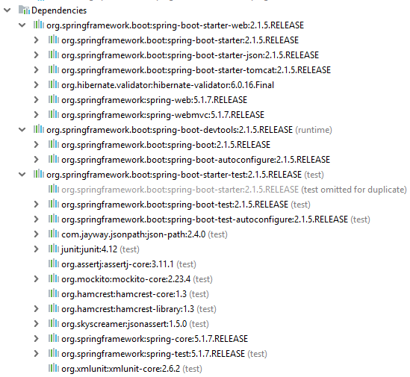
Spring Boot Starters - Web and JPA
Spring Boot Starter Web
Compatible Dependencies that are needed to develop web applications
Auto Configuration
Dependencies can be classified into:
Spring - core, beans, context, aop
Web MVC - (Spring MVC)
Jackson - for JSON Binding
Validation - Hibernate Validator, Validation API
Embedded Servlet Container - Tomcat
Logging - logback, slf4j

Slide 13
Spring Boot Starter Parent
What is Spring Boot Starter Parent?
All Spring Boot projects typically use spring-boot-starter-parent as the parent in pom.xml
Parent Poms allow you to manage the following things for multiple child projects and modules:
Configuration - Java Version and Other Properties
Dependency Management - Version of dependencies
Default Plugin Configuration
<parent>
<groupId>org.springframework.boot</groupId>
<artifactId>spring-boot-starter-parent</artifactId>
<version>2.1.5.RELEASE</version>
<relativePath/> <!-- lookup parent from repository -->
</parent>

Slide 14
Spring Boot Developer Tools and Live Reload
Problem with Server Restarts
When we develop our applications (Web or RESTful API), we would want to be able to test our changes quickly
Typically, in the Java world, we need to restart the server to pick up the changes
Adding Spring Boot Developer Tools to Your Project
Go ahead and make a simple change to your controller. You would see that these changes are automatically picked up(it is more eclipse friendly ☺)
<parent>
<groupId>org.springframework.boot</groupId>
<artifactId>spring-boot-starter-parent</artifactId>
<version>2.1.5.RELEASE</version>
<relativePath/> <!-- lookup parent from repository -->
</parent>

Slide 15
Spring Boot Developer Tools and Live Reload
What kind of changes does Spring Boot Developer Tools pick up?
By default, any entry on the classpath that points to a folder will be monitored for changes
These folders will not trigger reload by default
/META-INF/maven
/META-INF/resources
/resources
/static
/public
/templates
You can configure additional folders to scan
spring.devtools.restart.exclude=static/**,public/**

Slide 16
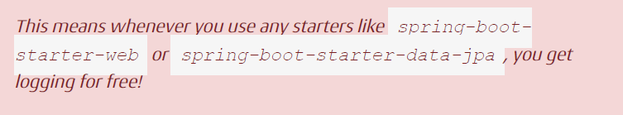
Logging with Spring Boot - Logback, SLF4j and LOG4j2
Spring boot provides a default starter for logging - spring-boot-starter-logging
It is included by default in spring-boot-starter which is included in all other starters
Let’s look at what is present in the Logging Starter
Configure Logging Levels
logging.level.some.package.path=DEBUG
logging.level.some.other.package.path=ERROR
logging.file=\path_to\logfile.log
Logger logger = LoggerFactory.getLogger(this.getClass());
logger.trace("Your log - {}", value);
logger.debug("debug - {}", value);
logger.info("info- {}", value);
logger.warn("warn - {}", value);
logger.error("error - {}", value);
<dependency>
<groupId>ch.qos.logback</groupId>
<artifactId>logback-access</artifactId>
<version>1.2.3</version>
</dependency>
<dependency>
<groupId>org.apache.logging.log4j</groupId>
<artifactId>log4j-to-slf4j</artifactId>
<version>2.11.2</version>
</dependency>
<dependency>
<groupId>org.slf4j</groupId>
<artifactId>jul-to-slf4j</artifactId>
<version>1.7.26</version>
</dependency>
<dependency>
<groupId>org.slf4j</groupId>
<artifactId>log4j-over-slf4j</artifactId>
<version>1.7.26</version>
</dependency>

Slide 17
Logging with Spring Boot - Logback, SLF4j and LOG4j2
Using Log4j2 for logging with Spring Boot
We would need to exclude the dependency on spring-boot-starterlogging and add a dependency on spring-boot-starter-log4j2
Custom configuration using log4j2.xml
You also have the option of using YAML or JSON with Log4j2
YAML - log4j2.yaml or log4j2.yml
JSON - log4j2.json or log4j2.jsn
However, you would need to include the appropriate dependency to handle yaml(jackson-dataformat-yaml) or json(jackson-databind)
<dependency>
<groupId>org.springframework.boot</groupId>
<artifactId>spring-boot-starter</artifactId>
<exclusions>
<exclusion>
<groupId>org.springframework.boot</groupId>
<artifactId>spring-boot-starterlogging</
artifactId>
</exclusion>
</exclusions>
</dependency>
<dependency>
<groupId>org.springframework.boot</groupId>
<artifactId>spring-boot-starter-log4j2</artifactId>
</dependency>

Slide 18
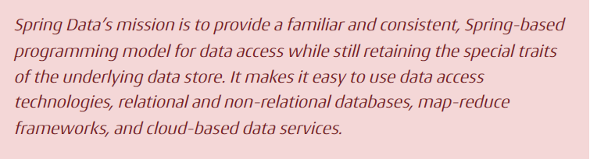
Introduction to Spring Data
What is Spring Data?
When Spring Framework was created, in early 2000s, the only kind of database was relational database - Oracle, MS SQL Server, My SQL etc
In the last few years, there are a wide variety of databases that are getting popular - most of them not relational and not using SQL. NoSQL, for example
To make it simpler, Spring Data provides Abstractions (interfaces) you can use irrespective of underlying data source

Slide 19
Introduction to Spring Data
Crud Repository
public interface CrudRepository<T, ID> extends Repository<T, ID>
PagingAndSortingRepository
Sort your data using Sort interface
Paginate your data using Pageable interface, which provides methods for pagination - getPageNumber(), getPageSize(), next(), previousOrFirst() etc.
Defining custom queries
List<Person> findByFirstNameAndLastname(String firstName, String lastname);
Above method helps you search a data store by passing in the first name and last name of a person. This would generate the ppropriate query for the data store to return the person details
Auditing with Spring Data
class Student {
@CreatedBy
private User createdUser;
@CreatedDate
private DateTime createdDate;
// … further properties omitted
}

Slide 20
Introduction to Spring Data
Spring Data Implementations
Spring Data JPA - Connect to relational databases using ORM frameworks.
Spring Data MongoDB - Repositories for MongoDB.
Spring Data REST - Exposes HATEOAS RESTful resources around Spring Data repositories.
Spring Data Redis - Repositories for Redis.
Spring Data JPA helps you to connect to relational databases using ORM frameworks.
public interface JpaRepository<T, ID> extends PagingAndSortingRepository<T, ID>, QueryByExampleExecutor<T>
Exposing as a REST API
@RepositoryRestResource(collectionResourceRel = "rates", path = "rates")
<dependency>
<groupId>org.springframework.boot</groupId>
<artifactId>spring-boot-starter-data-jpa</artifactId>
</dependency>

Slide 21
Introduction to Spring Data
spring-boot-starter-data-rest
Spring Data REST is using the HATEOAS (Hypermedia As The Engine Of Application State)
Each resource has its own URI
You always transfer the whole state of your object behind an endpoint
if you want to change it, manipulate it in your client and send it back to the server
supports HAL (Hypertext Application Language) as a semantic layer
As HATEOAS itself has no rules of how things like linking between resources, pagination, searches and other various meta data related task are handled, a few rivaling solutions exist, and HAL is for Spring Data REST HAL the winner
<dependency>
<groupId>org.springframework.boot</groupId>
<artifactId>spring-boot-starter-data-rest</artifactId>
</dependency>

Slide 22
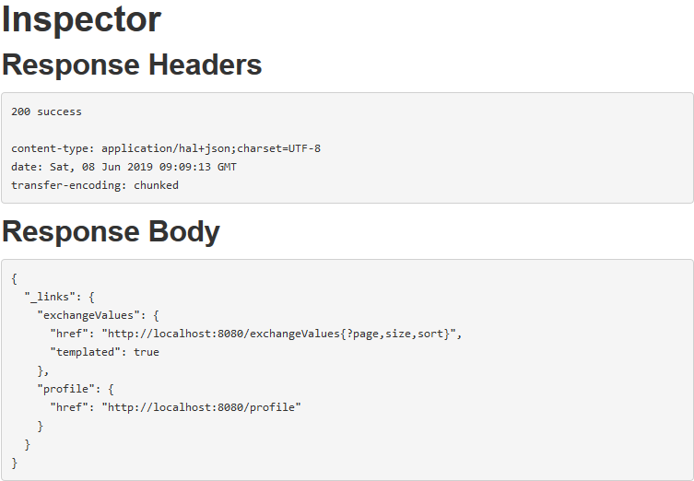
Introduction to Spring Data
Explore in spring-boot-starter-data-rest with HAL Browser
http://localhost:8080/
__links_ is part of HAL and give an overview which links are available on exactly this endpoint
profile exposes additional meta data a potential client could use. We will ignore the profile and discover what users has to offer
Add a new rate
call exchangeValues with POST method
Modifying a rate
Call /X with PUT method to modify all fields
Call /X with PATCH method to modify specific fields
Detele a rate
Call /X with DETELTE method
/exchangeValues{?page,size,sort}
/search/findByFromAndTo{?from,to}

Slide 23
Introduction to Spring Data
RepositoryDetectionStrategy
DEFAULT: all public repository interfaces but considers settings on annotations
ALL: all repositories independently of type visibility and annotations
ANNOTATION: only annotated repositories unless they are set to false
VISIBILITY: only public annotated repositories
You can change the strategy by providing the RepositoryRestConfigurer in your @Configuration
Annotations
@RestResource is used on model classes and define how to expose the model
@RepositoryRestResource is used on repositories and define how to expose the model

Slide 24


